Slide 1


Slide 2


ExamHub: Revolutionizing Educational Assessment
Welcome to ExamHub, the next-generation exam management platform! We're streamlining course and test administration, designed for educators and institutions. This presentation will provide an overview of ExamHub's purpose, functionality, tech stack, and key features.
by Abdur Rahman Qureshi & Sofiya Patwekar

Slide 3

The Problem in Educational Technology
Challenges in Education
78% of educators struggle with manual exam processes.
Time-consuming test creation and grading impact efficiency.
Limited flexibility in assessment methods hinders innovation.
Educators face numerous challenges in managing exams and courses efficiently. Manual processes, time constraints, and limited flexibility create significant hurdles.
Fragmented educational technology solutions add complexity.

Slide 4

ExamHub: Solution Overview
Comprehensive Platform
Simplified Assessment
ExamHub is a comprehensive web application designed for effective exam management.
Our platform simplifies the entire educational assessment process, from creation to grading.
Multiple Environments
ExamHub supports various educational settings, providing versatility for different institutions.

Slide 5
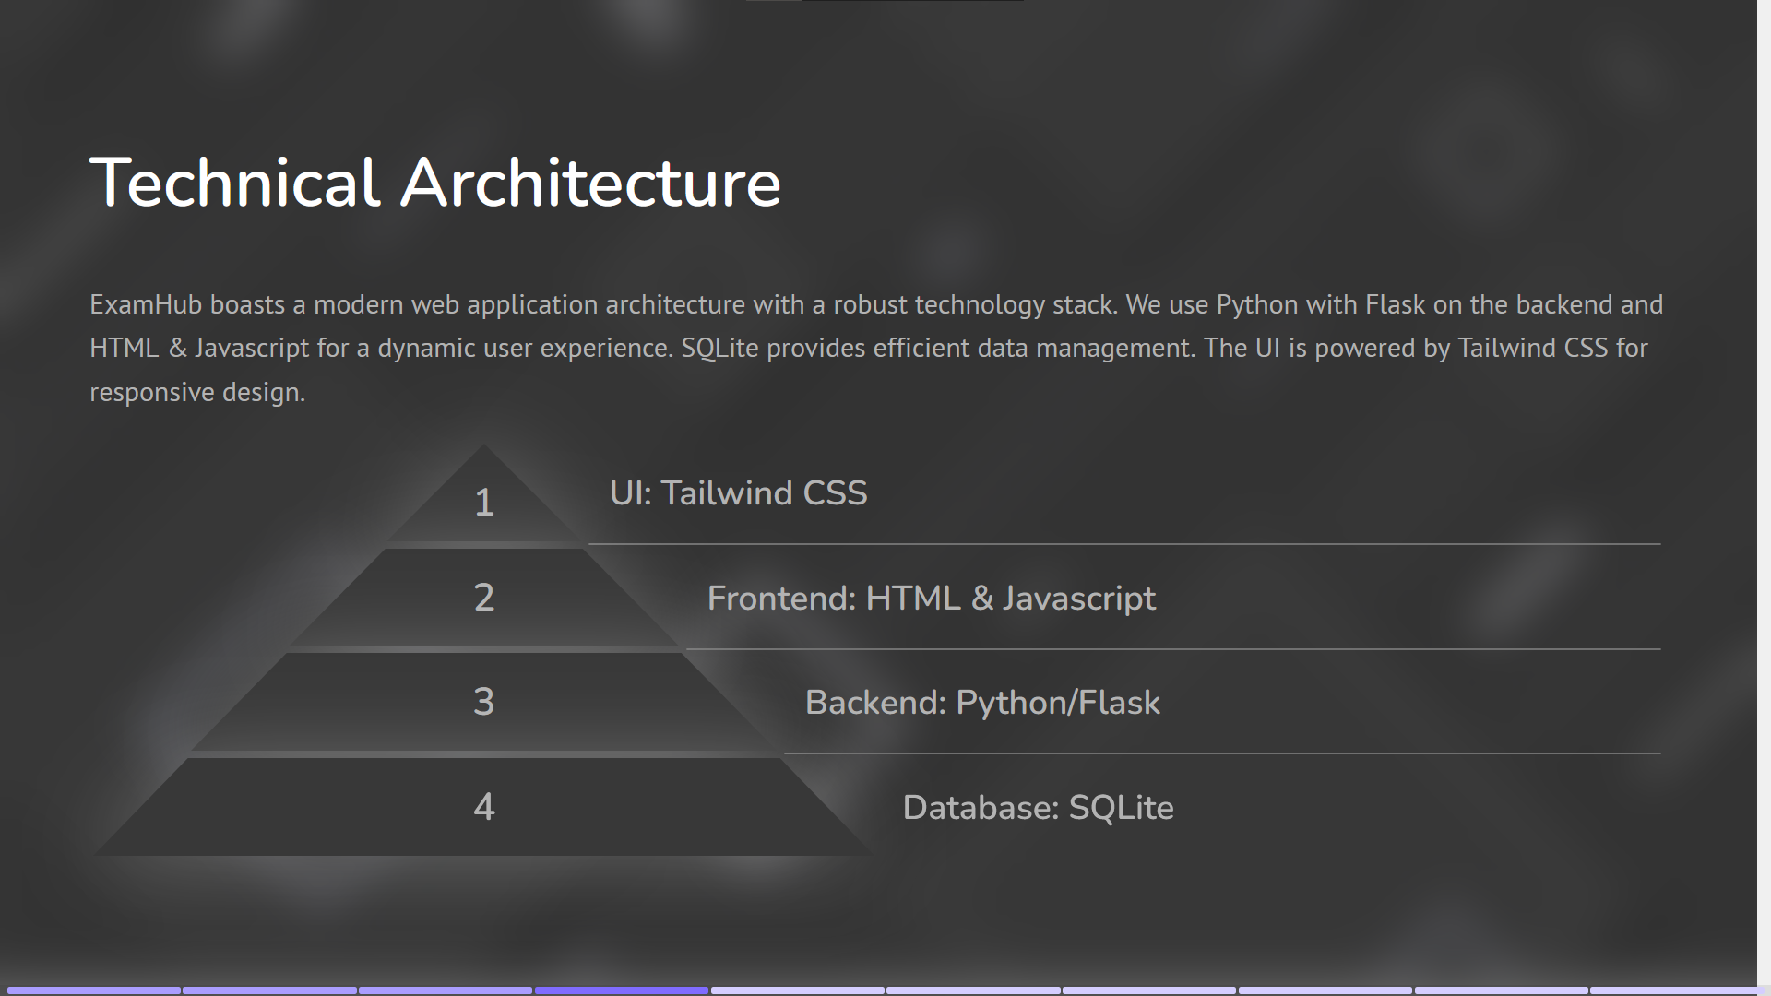






Slide 6

Exam Management Capabilities
1
Rapid Exam Creation
2
Versatile Question Types
Create exams in less than 15 minutes with our intuitive tools.
Supports multiple question types, including MCQs and essays.
3
Automatic Grading
Automated grading for objective questions saves time and effort.

Slide 7


Slide 8


Slide 9


Slide 10
Advanced Test Creation Interface
Drag-and-Drop
1
Easy question builder
Rich Media
2
Integrate multimedia elements
Real-Time Preview
3
View your exam instantly
ExamHub's test creation interface provides intuitive tools for designing exams. Features include a drag-and-drop question builder, rich media integration, template-based design, and real-time preview. Accessibility is a key focus, ensuring a user-friendly experience for all educators.

Slide 11
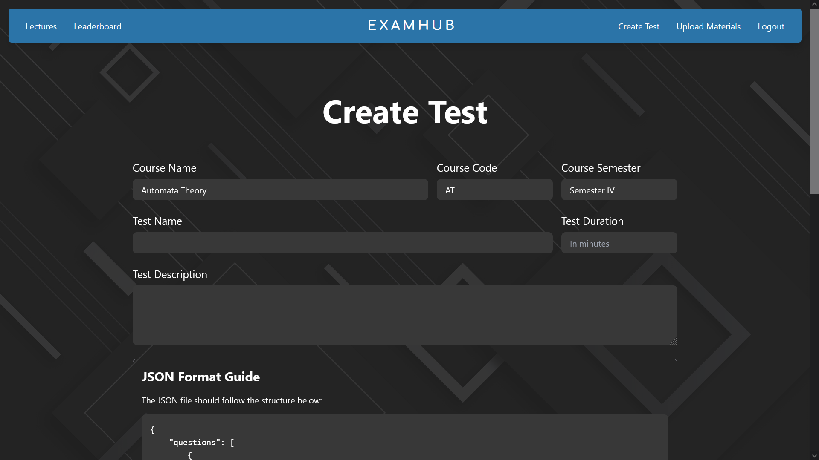

Slide 12
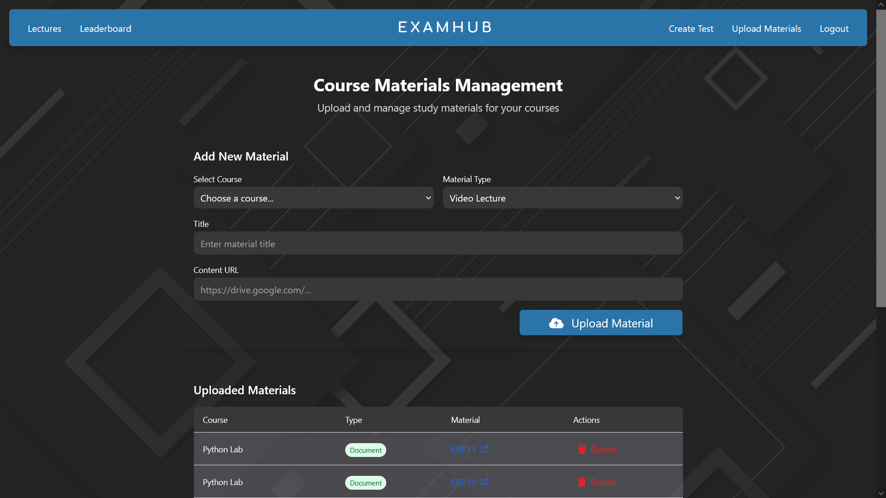

Slide 13
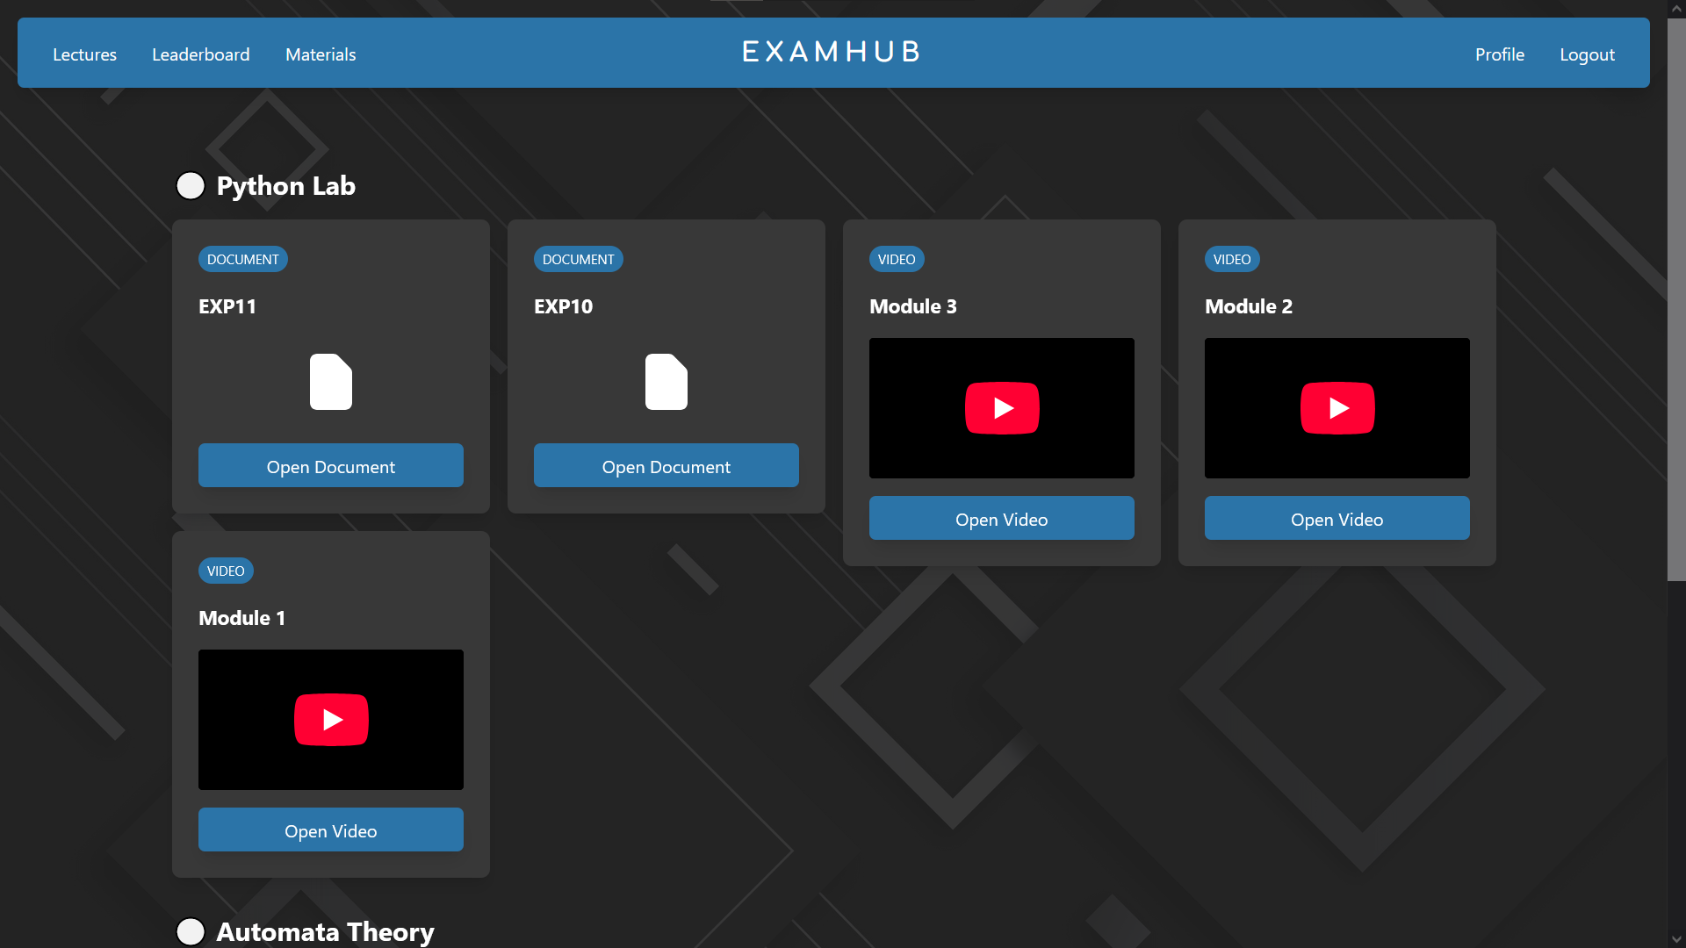

Slide 14




Course Management System
Content Management
1
Enrollment Tracking
2
4
Integration
3
Performance Tracking
Our course management system offers centralized content control, student enrollment and tracking, grade book functionalities, and seamless integration with existing educational platforms. Manage your courses efficiently and effectively with ExamHub.

Slide 15
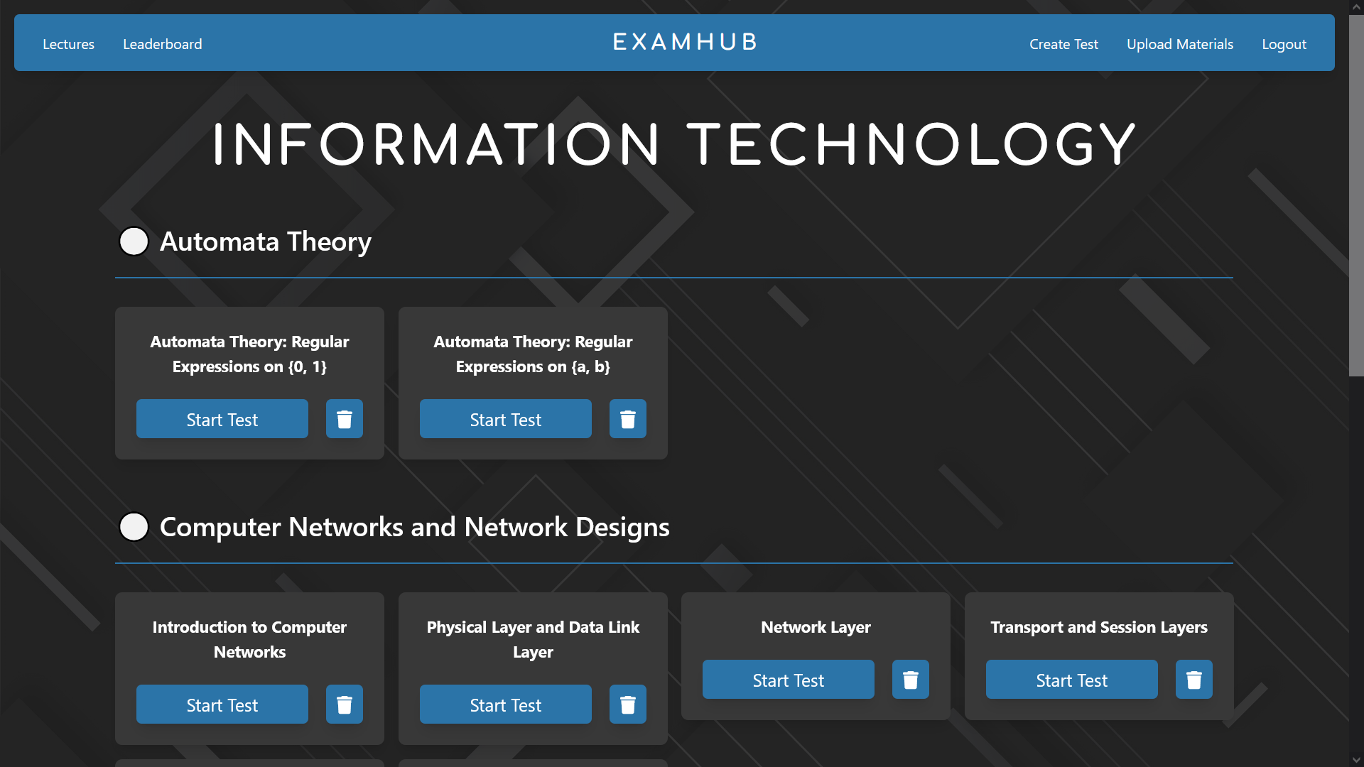

Slide 16
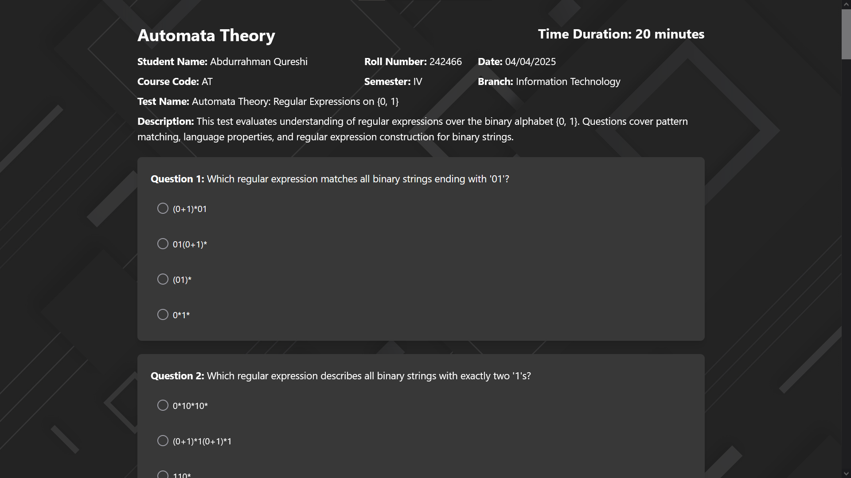

Slide 17




Database and Security Features
SQLite Backend
Robust and reliable data storage.
Role-Based Access
Secure access control.
Encrypted Authentication
Ensuring user security.
ExamHub employs a robust SQLite backend to ensure data integrity. We utilize role-based access control, encrypted user authentication, and consider GDPR and FERPA compliance. Regular automated backups protect your data.

Slide 18


Slide 19


Slide 20
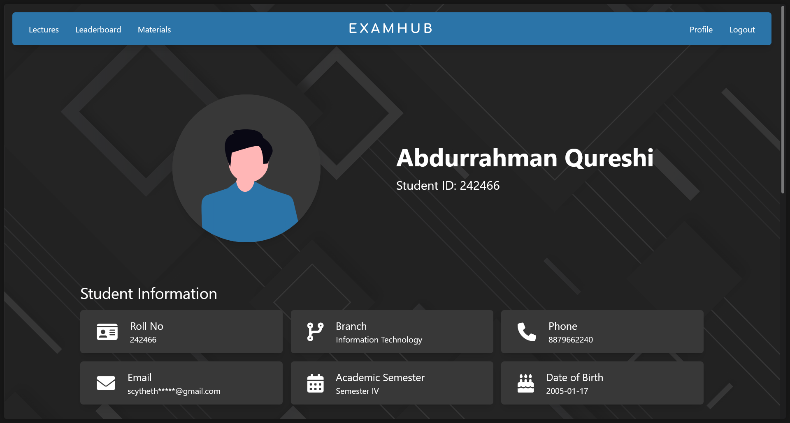

Slide 21
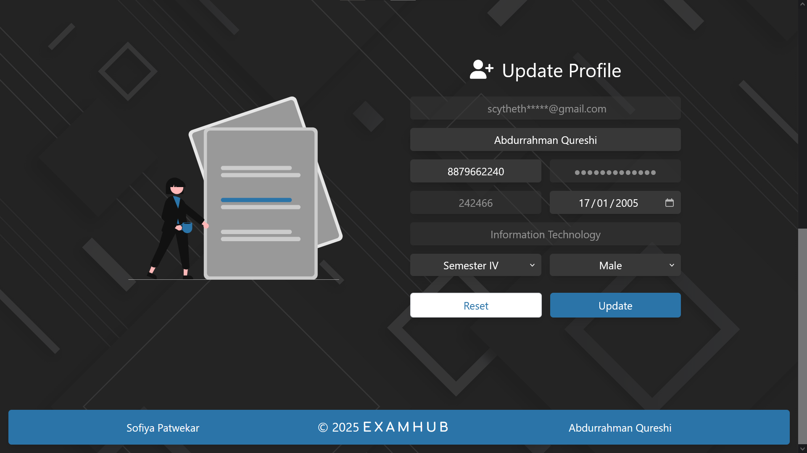

Slide 22





Future Roadmap and Vision
1
Global Impact
2
Continuous UX
3
LMS Integration
4
Assessment Analytics
5
AI Question Gen
Our future roadmap includes AI-powered question generation, machine learning assessment analytics, integration with learning management systems, and continuous user experience improvements. We aim to expand our global impact and revolutionize educational technology.

